Slide 1
Computational Drug Repositioning ( 2 )
: From Data to Therapeutics
MR Hurle, L Yang , Q Xie, DK Rajpal, P Sanseau and P Agarwal
APRIL 2013 Nature

Slide 2
Overview
Genetics
Other Methods
Pathway and Network
Screening
Off-target effects
in vivo
Therapeutic effects
Observational studies, EHRs, and social media
3. Conclusion

Slide 3
Genetics
Human genetics studies offer one of the strongest lines of evidence to connect specific genes to specific human diseases.
Recent technological advances such as next-generation sequencing have accelerated the discovery of gene-disease associations by drastically reducing the cost of whole-exome sequencing.
Genome-wide association studies (GWAS) have shown the association between genetic variants and polygenic diseases, resulting in the identification of genes proximal to these variants as being linked to numerous complex disease.
It is evident that the gene-disease association identified by GWAS inform possible drug repositioning opportunities.

Slide 4
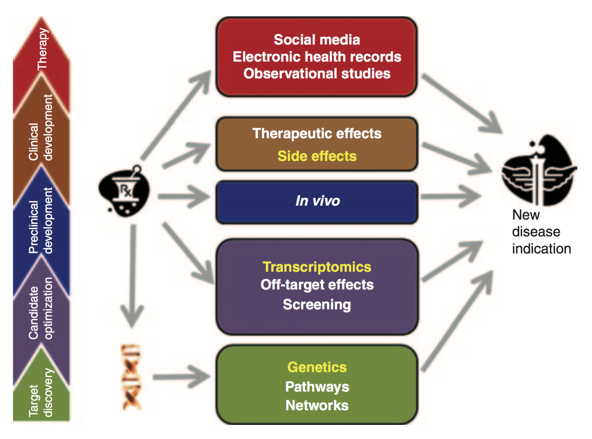
Other Methods
The various stages of drug discovery produce additional data relevant to repurposing.

Slide 5
Other Methods : Pathway and Network
Diseases can be connected to one another in a network on the basis of shared features.
Chiang and Butte used another disease similarity approach that they termed “guilt by association”
The researchers showed that suggestions based on this method were 12 times more likely to lead to a clinical trial with the hypotheses.
However, the black-box nature of these predictions can present a challenge for experimental verification.
If the precision of these techniques is proven to be high, they will gain more widespread acceptance and will be experimentally validated.

Slide 6
Other Methods : Screening
High-throughput screening results may be a rich source of repositioning hypotheses.
If a drug or a closely related molecule is active in a phenotypic screen, it presents the simplest of cases for reposition- ing, and it should be tested in the disease associated with that phenotype.
Screening is conceivable that similar approaches may be used to predict disease indications as well.

Slide 7
Other Methods : Off-target effects
An approach that uses knowledge of both compound and protein structure is molecular docking,50 which estimates the physicochemical strength of ligand–protein interactions.
This approach has successfully identified the psychiatric drug haloperidol as a lead anti-HIV compound.
Because the compound will also bind to its originally identified target under most conditions, repositioning between anti-infective drugs and human targets is likely to be the most efficacious application of off -target methods.

Slide 8
Other Methods : In vivo
In vivo phenotypic screening targeted mutations has been widely used to associate genes with phenotypes.
The Mouse Phenome Database (http://phenome.jax.org) contains about 1,400 phenotypic measurements related to human dis- eases, including cancer susceptibility, aging, obesity, infections, atherosclerosis, blood disorders etc.
We believe such data will play an increasing role in future repositioning efforts, although the translation of findings from in vivo models to humans may prove challenging.

Slide 9
Other Methods : Therapeutic effects
Although success stories have been reported on repositioning of drugs on the basis of clinical observations of pharmacologic effects in human patients, there is a paucity of published literature on the systematic use of repositioning.
This is perhaps a consequence of the lack of publicly available clinical trial data.
however, such clinical trial data are now becoming more readily available.

Slide 10
Other Methods : Observational studies, EHRs, and social media
As drugs progress into the clinic, they generate clinical data that can be analyzed for repositioning opportunities. The almost incomprehensible volume and complexity of EHRs present opportunities that could well be the source of the next great advances in drug repositioning.
Experimental validation and independent validation add verify to computational hypothesis.
Without a computational hypothesis, a preclinical or clinical hypothesis may not be actionable; however, once the two are put together, they can accelerate the path toward a clinical trial.

Slide 11
Conclusion
It is also indisputable that repositioning is a key value driver.
Many national institutes have announced public-private partnership to repurpose failed pipeline drugs.
The rise of translational bioinformatics as a discipline suggests that the field of computational biology is maturing and is perhaps more ready than ever to develop solutions that will have a beneficial impact on human health in the near term.

